Slide 1
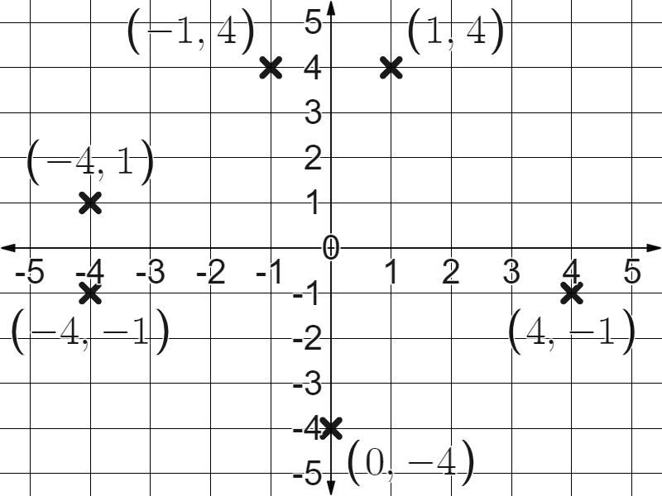
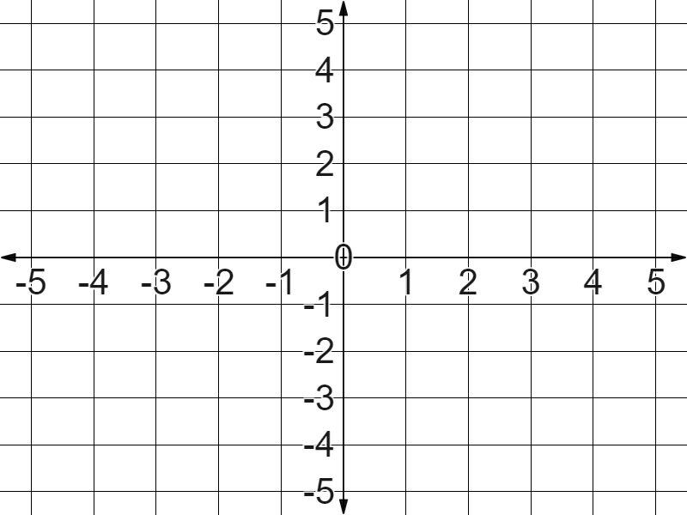
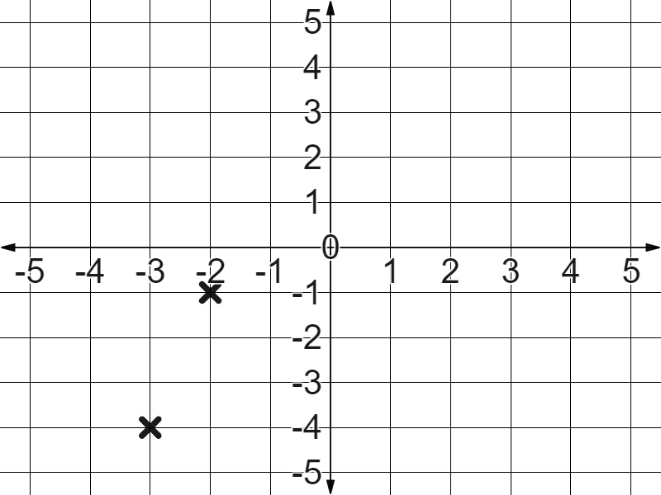

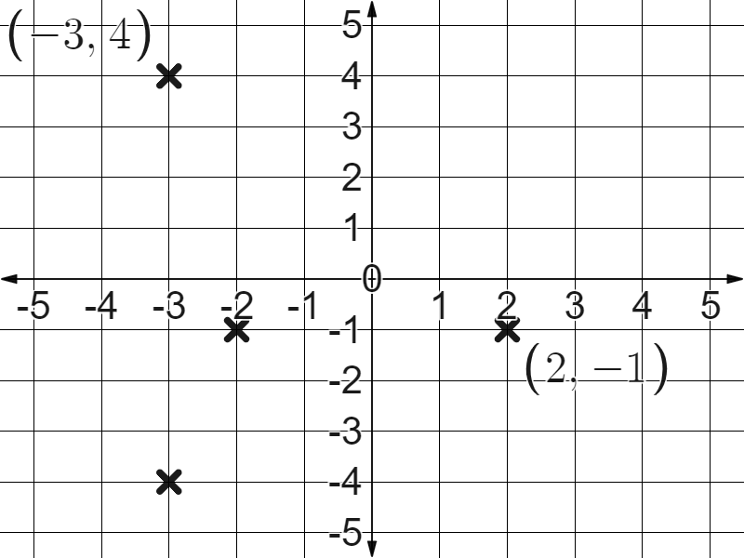
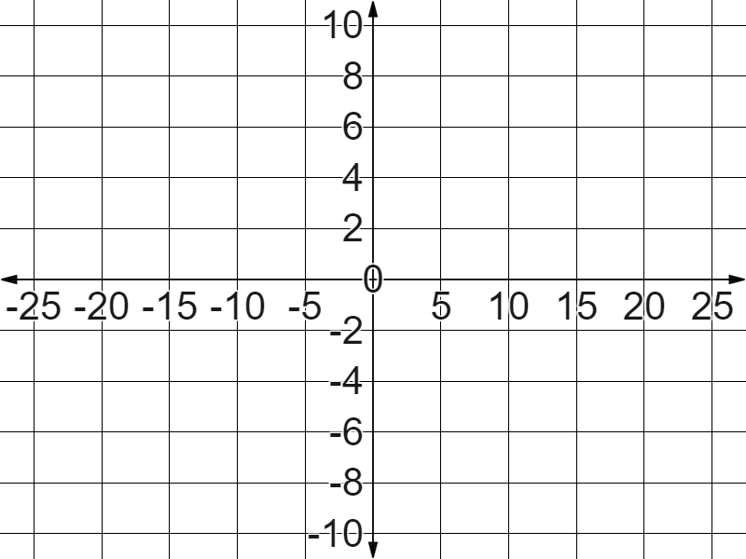
Securing understanding of plotting coordinates
Task A: Plotting coordinates in all four quadrants
1) Plot the below coordinates:
(1, 4)
(-1, 4)
(-4, 1)
(-4, -1)
(4, -1)
(0, -4)
2) In Laura’s book you see that she has plotted the coordinates (2, -1) and (-3, 4) like this.
Your feedback might have included, “follow the axes in the correct direction depending on the value of the coordinates”
Task B: Drawing axes
1) Fill in the blanks to label this coordinate grid, keeping the scale in ones.
Don’t forget to start with the origin and work outwards.
2) Fill in the blanks to label this coordinate grid.
Be sure to keep the scale along each axis consistent.

Slide 2
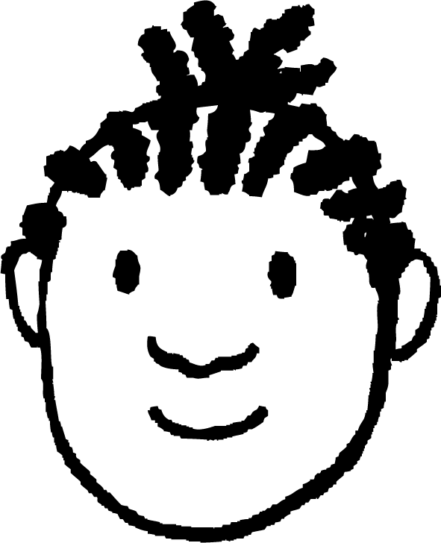
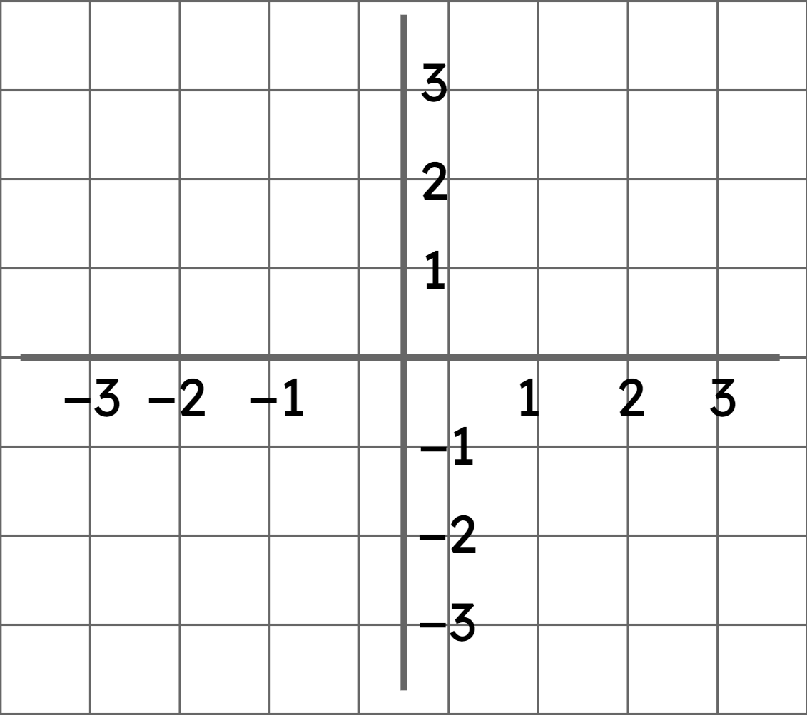
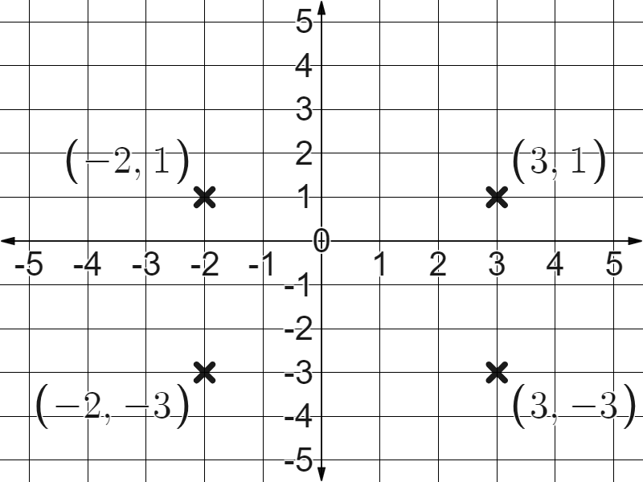
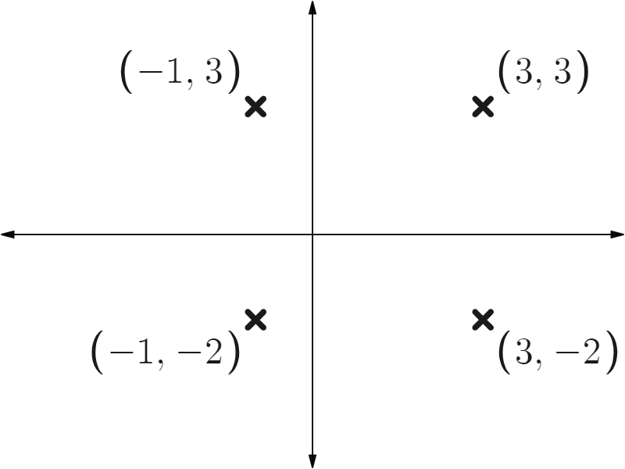
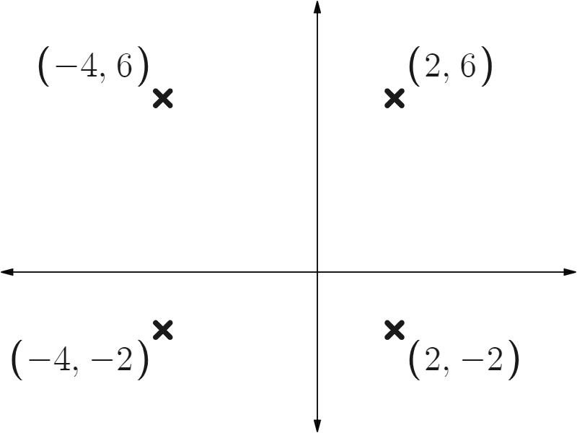
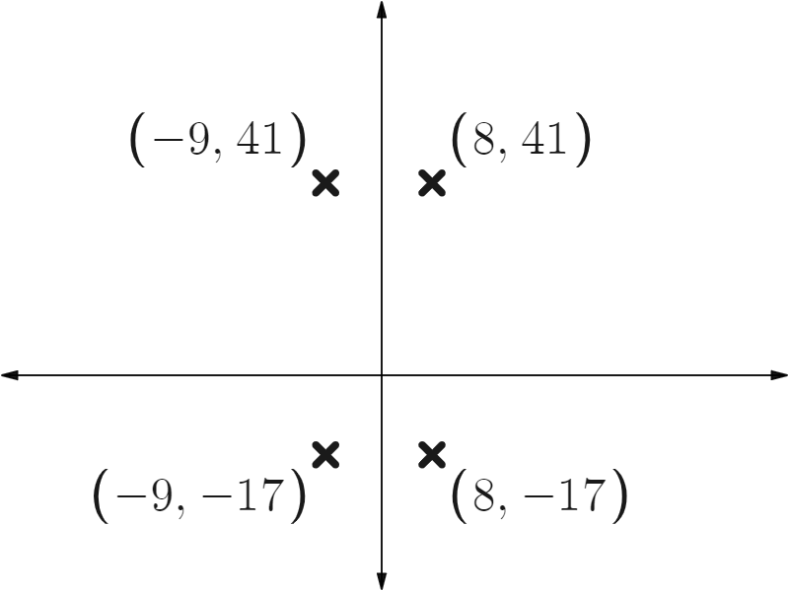
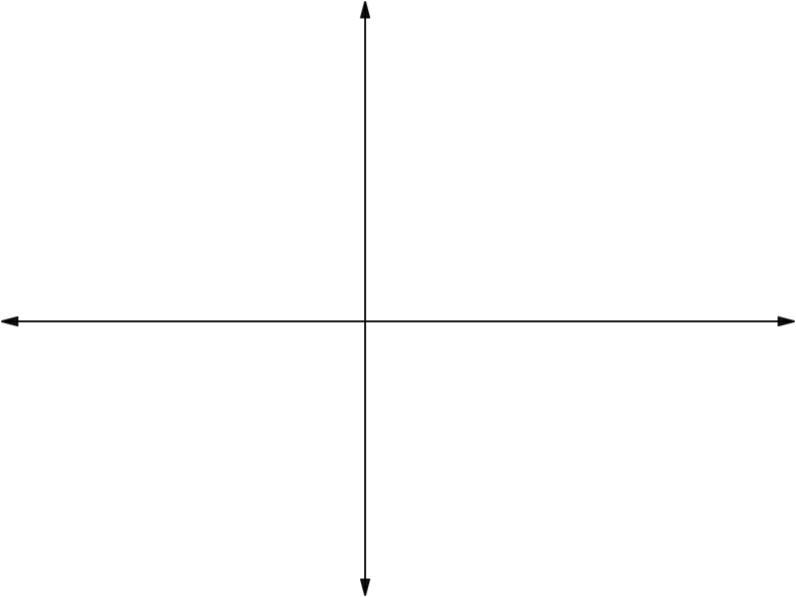
Securing understanding of plotting coordinates
3) You see this in Jacob’s book.
What advice would you give him to improve his work?
Your advice might have included:
Label your and axis.
Make sure your axis lines up with the lines in your book.
When labelling, start with the origin and work outwards.
Task C: Plotting shapes in all four quadrants
1) Plot these coordinates.
What shape do they form?
(3, 1)
(-2, 1)
(-2, -3)
(3, -3)
A rectangle.
2) Fill in the blank coordinates of these rectangles.
a)
b)
c)
d)
(c, b)
✖
✖
(a, b)
(c, d)
✖
✖
(a, d)
Mathematics in Education and Industry.
v2.2

